Slide 1



Cryptology
Cryptography, or cryptology (from Ancient Greek: κρυπτός, romanized: kryptós "hidden, secret"; and γράφειν graphein, "to write", or -λογία -logia, "study", respectively), is the practice and study of techniques for secure communication in the presence of adversarial behavior.
An Introduction
Third Edition by William Stallings Lecture slides by Lawrie Brown
canoztas

Slide 2

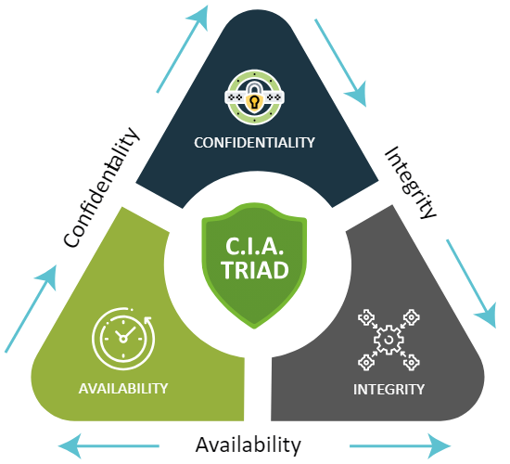

CIA

Slide 3


Chapter 1 – Introduction
The art of war teaches us to rely not on the likelihood of the enemy's not coming, but on our own readiness to receive him; not on the chance of his not attacking, but rather on the fact that we have made our position unassailable.
—The Art of War, Sun Tzu

Slide 4
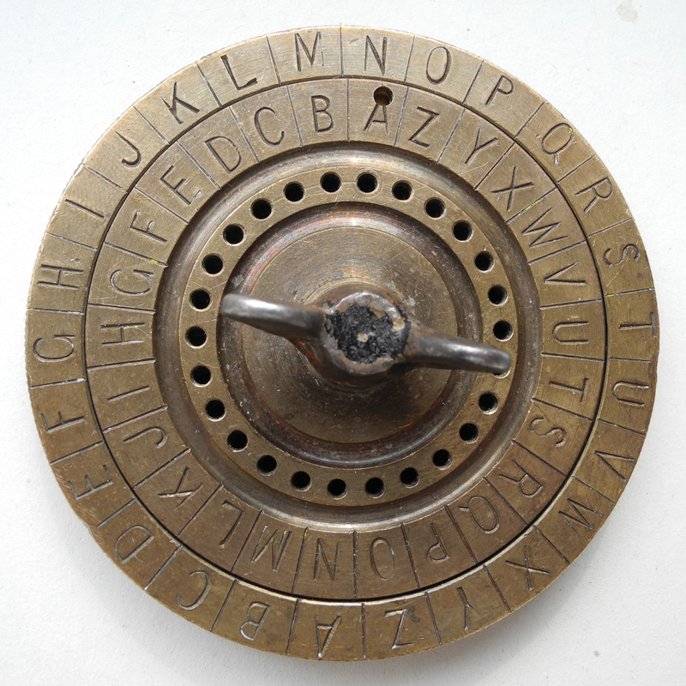
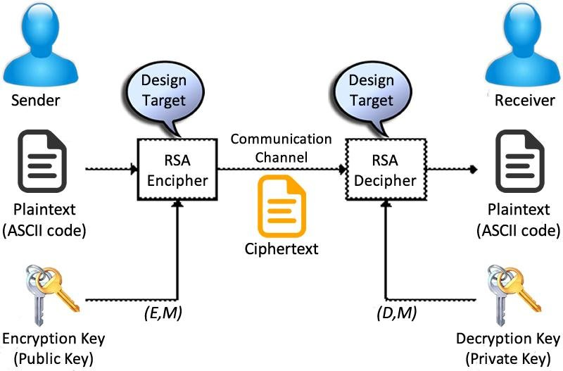
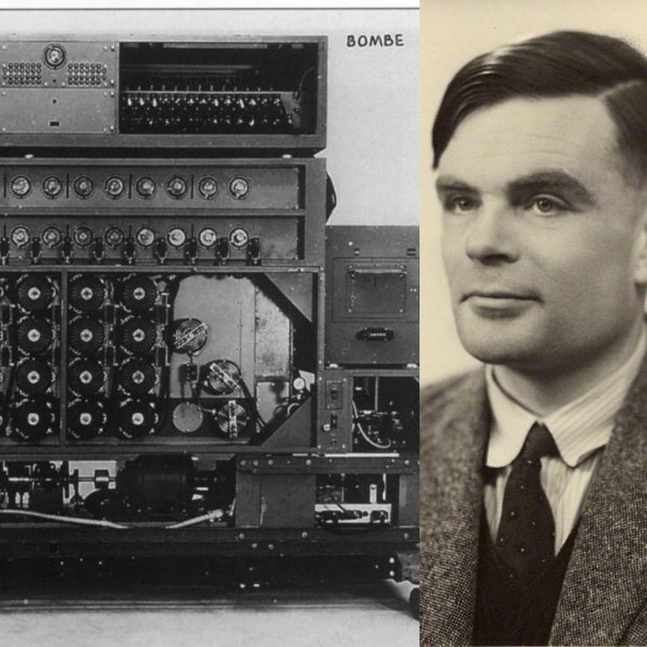
History

Slide 5
• Computer Security - generic name for the collection of tools designed to protect data and to thwart hackers
• Network Security - measures to protect data during their transmission
• Internet Security - measures to protect data during their transmission over a collection of interconnected networks
• need systematic way to define requirements
• consider three aspects of information security: – security attack – security mechanism – security service
• consider in reverse order

Slide 6
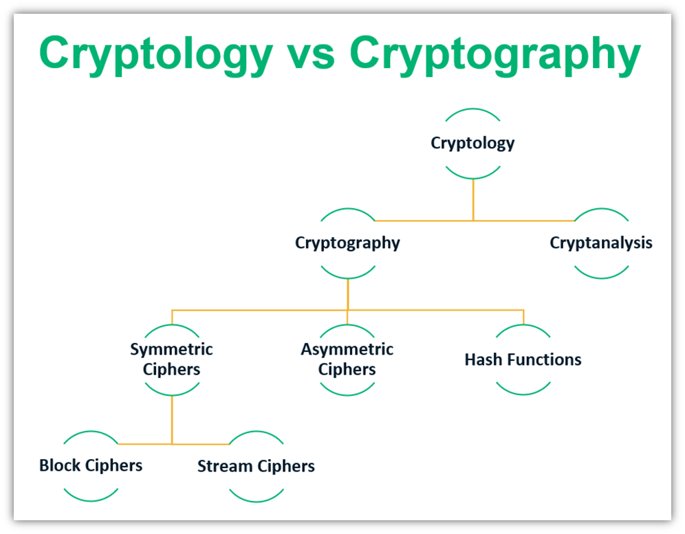

Slide 7
Security Attack
• any action that compromises the security of information owned by an organization • information security is about how to prevent attacks, or failing that, to detect attacks on information-based systems
• have a wide range of attacks
• can focus of generic types of attacks
• note: often threat & attack mean same
Security Mechanism
• a mechanism that is designed to detect, prevent, or recover from a security attack
• no single mechanism that will support all functions required
• however one particular element underlies many of the security mechanisms in use: cryptographic techniques
• hence our focus on this area

Slide 8
Security Services (X.800)
• Authentication - assurance that the
communicating entity is the one claimed
• Access Control - prevention of the
unauthorized use of a resource
• Data Confidentiality –protection of data from
unauthorized disclosure
• Data Integrity - assurance that data received is
as sent by an authorized entity
• Non-Repudiation - protection against denial by
one of the parties in a communication

Slide 9
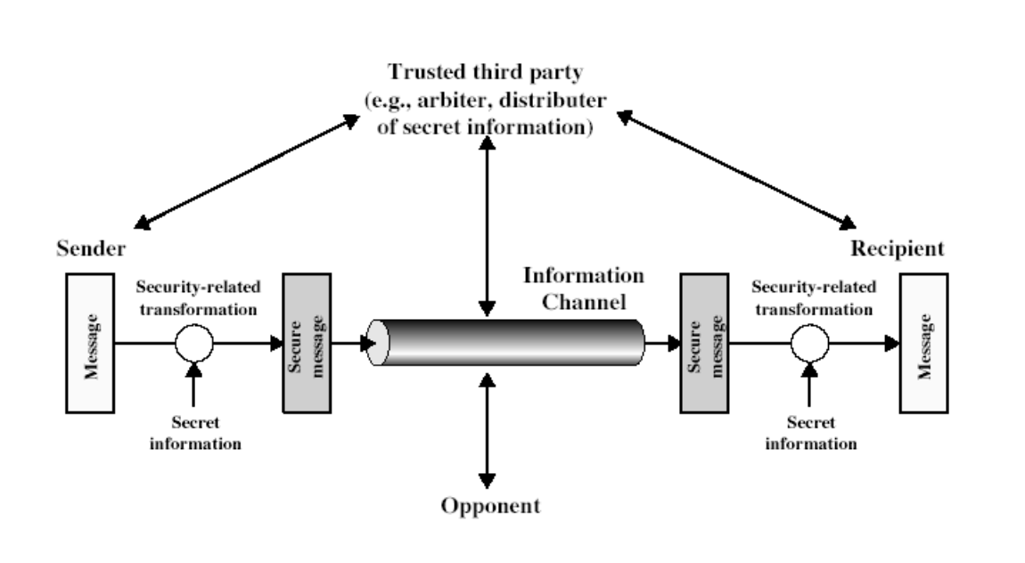

Slide 10
Basic Terminology
plaintext - the original message
ciphertext - the coded message
cipher - algorithm for transforming plaintext/ciphertext key - info used in cipher known only to sender/receiver encipher (encrypt) - converting plaintext to ciphertext decipher (decrypt) - recovering ciphertext from plaintext cryptography - study of encryption principles/methods cryptanalysis (codebreaking) - the study of principles/ methods of deciphering ciphertext without knowing key cryptology - the field of both cryptography and cryptanalysis

Slide 11

Symmetric Encryption
or conventional / private-key / single-key • was only type prior to invention of publickey in 1970’s • remains very widely used • sender and recipient share a common key – Both parties have full information of the key • all classical encryption algorithms are common key (private-key) – Characteristic of conventional algorithms

Slide 12
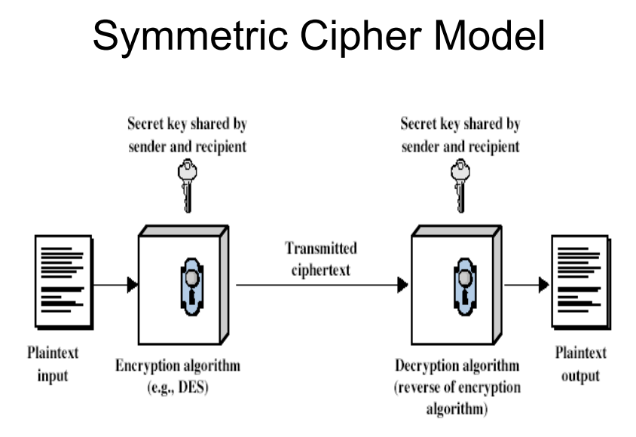
Symmetric Encryption

Slide 13
Symmetric Encryption
• two requirements for secure use of symmetric encryption:
– a strong encryption algorithm (keeping key secret is sufficient for security)
– a secret key known only to sender / receiver Y = EK (X)
X = DK (Y)
• assume encryption algorithm is known
• implies a secure channel to distribute key

Slide 14
Cryptography
can characterize by:
– type of encryption operations used • substitution / transposition / product systems
– number of keys used
• single-key or private / two-key or public – way in which plaintext is processed
• Block: process one block of elements a time
• Stream: continuous input, output one element a time

Slide 15
Types of Cryptanalytic Attacks
• ciphertext only – know a) algorithm b) ciphertext
• known plaintext – know some given plaintext/ciphertext pairs
• chosen plaintext – select plaintext and obtain ciphertext
• chosen ciphertext – select ciphertext and obtain plaintext
• chosen text – select either plaintext or ciphertext to en/decrypt to attack cipher

Slide 16
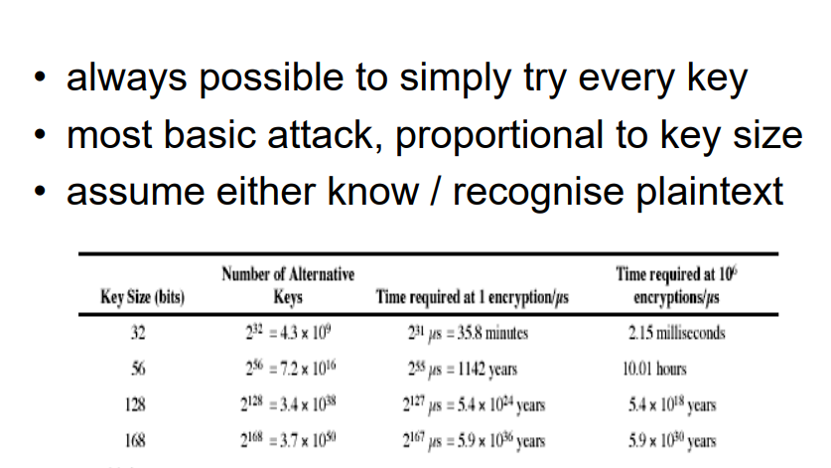

Slide 17
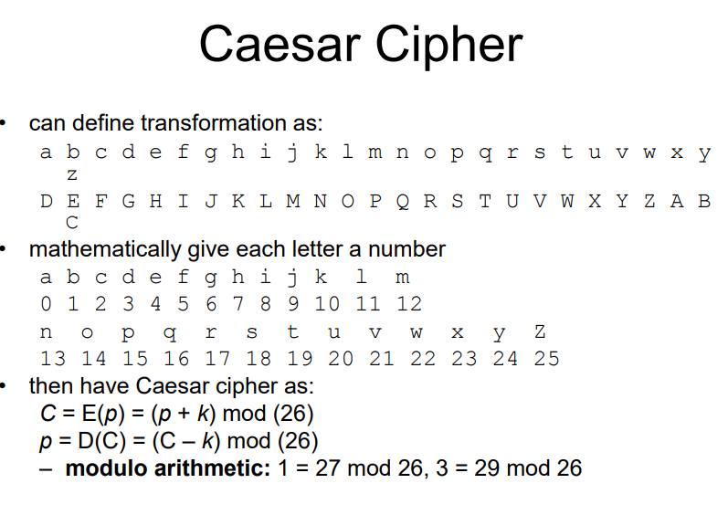

Slide 18
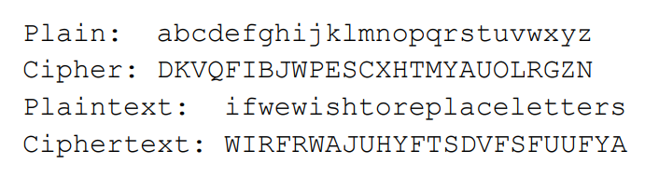
Monoalphabetic Cipher
• rather than just shifting the alphabet
• could shuffle the letters arbitrarily
• each plaintext letter maps to a different random
ciphertext letter
• hence key is 26 letters long

Slide 19
now have a total of 26! = 4 x 10^26 keys
• with so many keys, might think is secure – The simplicity and strength of the monoalphabetic substitution cipher dominated for the first millenium AD.
• but would be !!!WRONG!!!

Slide 20
Frequency Analysis
• letters are not equally commonly used
• in English e is by far the most common letter
• then T,R,N,I,O,A,S • other letters are fairly rare
• cf. Z,J,K,Q,X
• have tables of single, double & triple letter frequencies

Slide 21
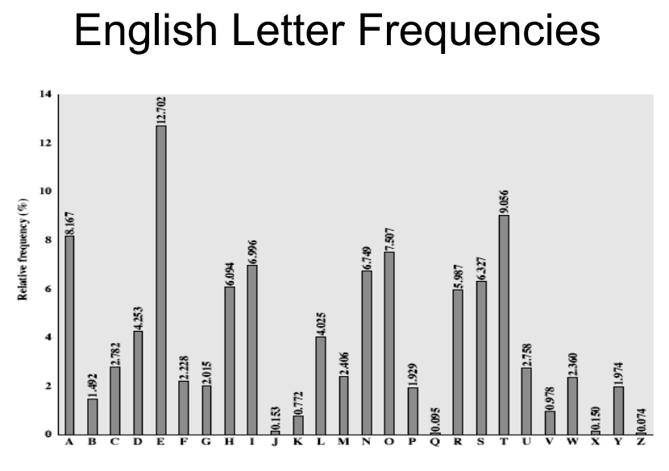
Frequency Analysis

Slide 22
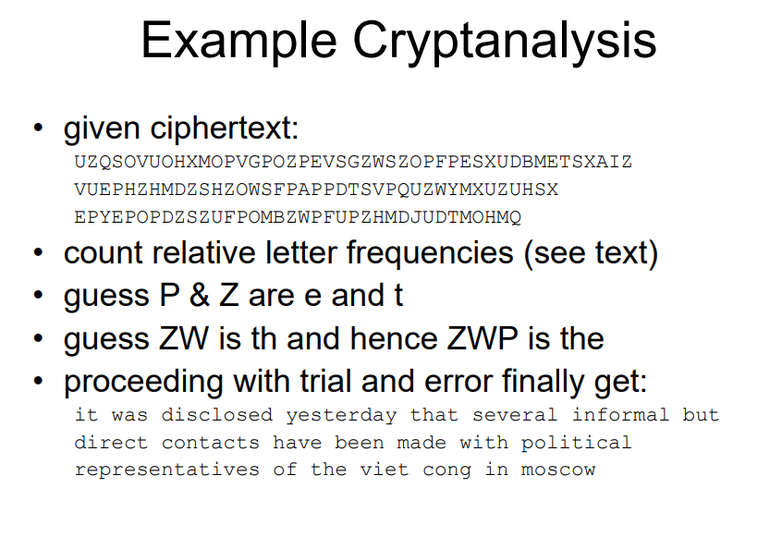
Frequency Analysis

Slide 23
Frequency Analysis

Slide 24
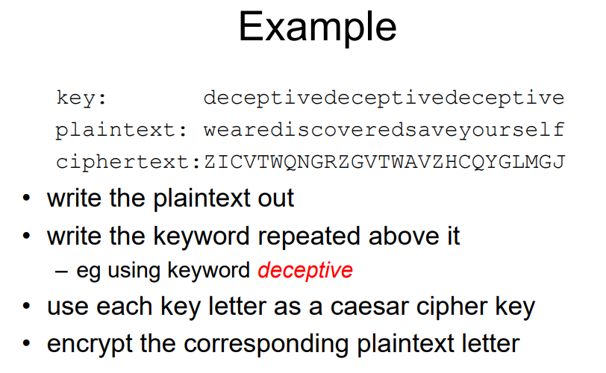
Polyalphabetic Ciphers
another approach to improving security is to use multiple cipher alphabets
• called polyalphabetic substitution ciphers
• makes cryptanalysis harder with more alphabets to guess and flatter frequency distribution
• use a key to select which alphabet is used for each letter of the message • use each alphabet in turn
• repeat from start after end of key is reached

Slide 25
Kasiski vs Vigenère
Autokey Cipher
One-Time Pad
Rail Fence Cipher
Row Transposition Ciphers
Product Ciphers
Rotor Machines

Slide 26
Steganography
an alternative to encryption
• hides existence of message
– using only a subset of letters/words in a longer message marked in some way
– using invisible ink
– hiding graphic image or sound file • has drawbacks
– high overhead to hide relatively few info bits

Slide 27
Chapter 3 – Block Ciphers and the Data Encryption Standard
Modern Block Ciphers
• will now look at modern block ciphers • one of the most widely used types of cryptography algorithms
• provide strong secrecy and/or authentication services
• in particular will introduce DES (Data Encryption Standard)

Slide 28
Block vs Stream Ciphers
• block ciphers process messages into blocks, each of which is then en/decrypted
• like a substitution on very big characters – 64-bits or more
• stream ciphers process messages a bit or byte at a time when en/decrypting • many current ciphers are block ciphers
• hence are focus of course

Slide 29
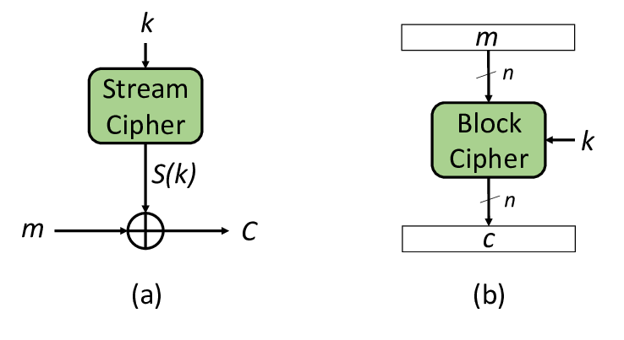
Block vs Stream Ciphers

Slide 30
Data Encryption Standard (DES)
• most widely used block cipher in world • adopted in 1977 by NBS (now NIST) – as FIPS PUB 46
• encrypts 64-bit data using 56-bit key
• has widespread use
DES History
• IBM developed Lucifer cipher
– by team led by Feistel
– used 64-bit data blocks with 128-bit key
• then redeveloped as a commercial cipher
with input from NSA and others
• in 1973 NBS issued request for proposals
for a national cipher standard
• IBM submitted their revised Lucifer which
was eventually accepted as the DES

Slide 31
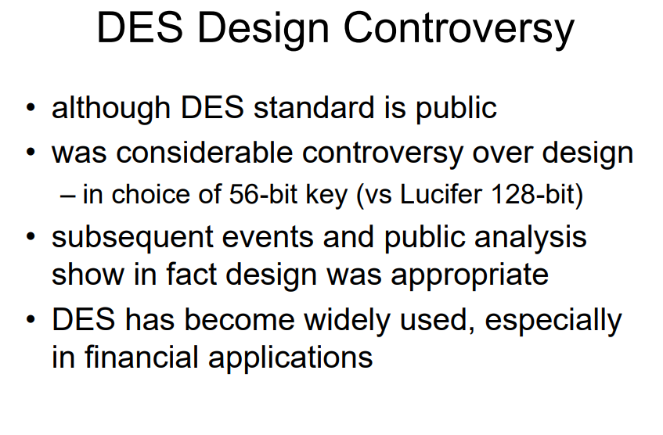

Slide 32
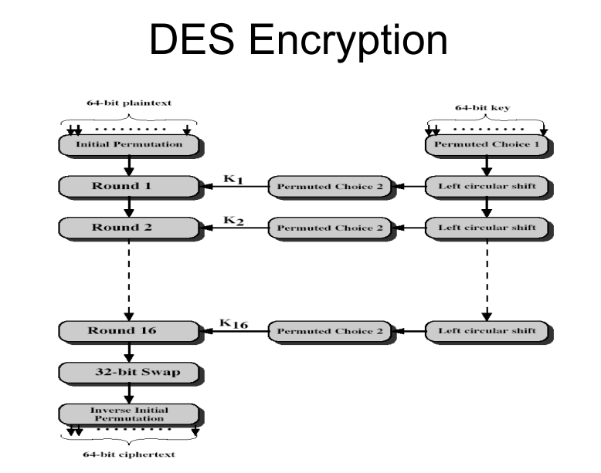
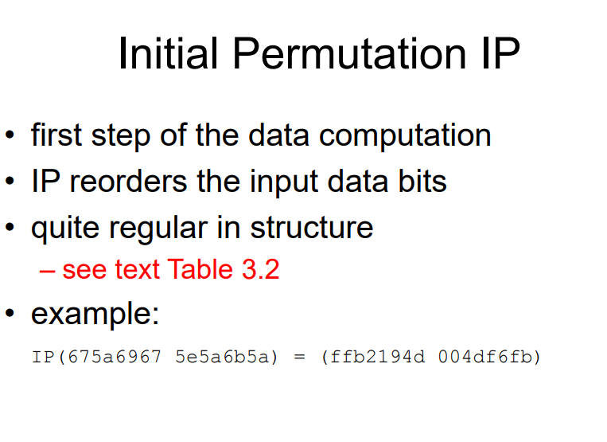

Slide 33
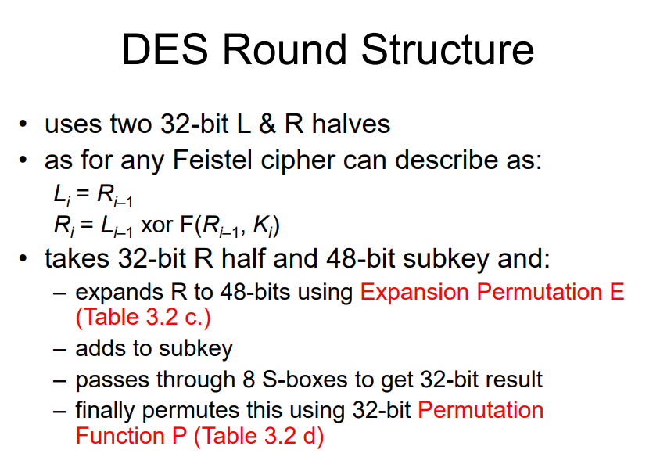

Slide 34
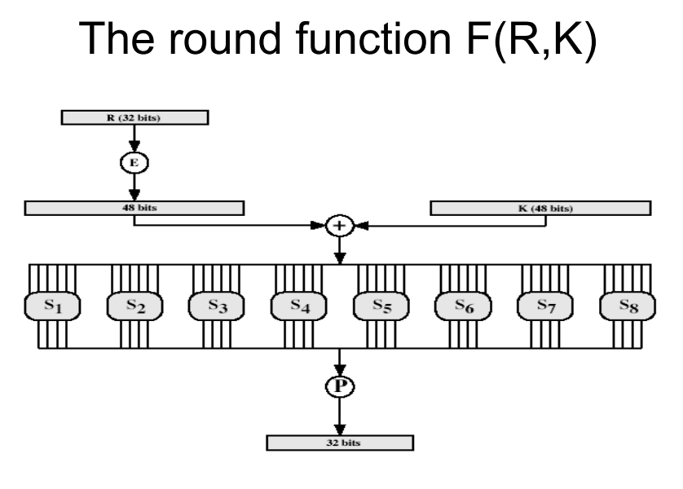

Slide 35
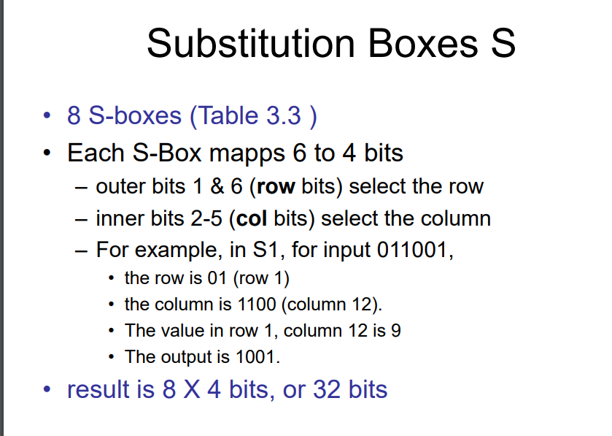

Slide 36
Strength of DES – Key Size
• 56-bit keys have 256 = 7.2 x 1016 values
• brute force search looks hard
• recent advances have shown is possible
– in 1997 on Internet in a few months
– in 1998 on dedicated hardware (EFF) in a few
days
– in 1999 above combined in 22hrs!
• still must be able to recognize plaintext
• now considering alternatives to DES

Slide 37
Strength of DES – Timing Attacks
• attacks actual implementation of cipher
• use knowledge of consequences of implementation to derive knowledge of some/all subkey bits
• specifically use fact that calculations can take varying times depending on the value of the inputs to it

Slide 38
Strength of DES – Analytic Attacks
• now have several analytic attacks on DES
• these utilise some deep structure of the cipher – by gathering information about encryptions – can eventually recover some/all of the sub-key bits – if necessary then exhaustively search for the rest
• generally these are statistical attacks
• include – differential cryptanalysis – linear cryptanalysis – related key attacks

Slide 39
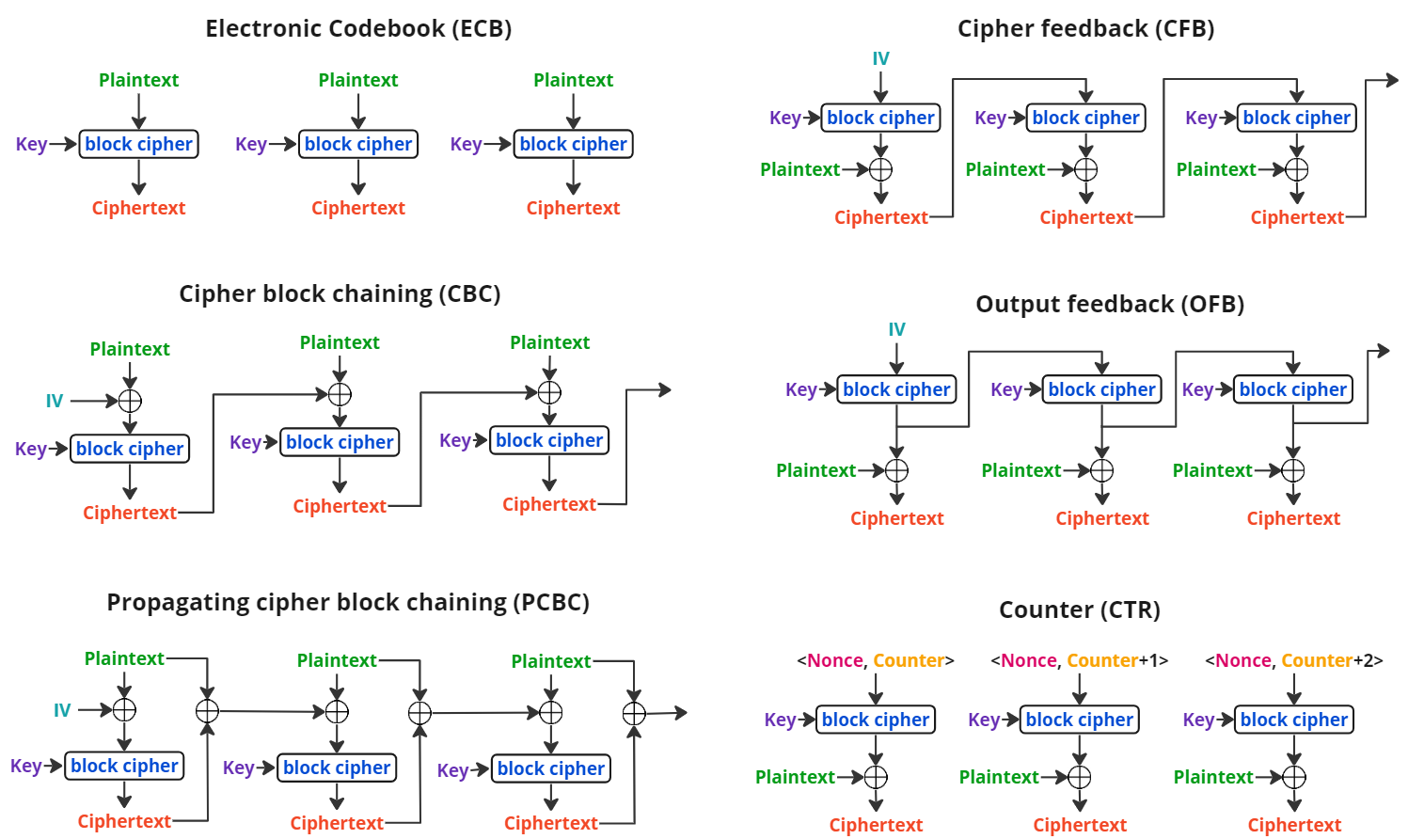

Slide 40
https://web.cs.hacettepe.edu.tr/~maydos/Docs/crypto/ch03.pdf

Slide 41
Chapter 4 – Finite Fields
• will now introduce finite fields
• of increasing importance in cryptography – AES, Elliptic Curve, IDEA, Public Key
• concern operations on “numbers” – what constitutes a “number” – the type of operations and the properties
• start with concepts of groups, rings, fields from abstract algebra

Slide 42
Chapter 5 Advanced Encryption Standard
clear a replacement for DES was needed
– have theoretical attacks that can break it
– have demonstrated exhaustive key search attacks
• can use Triple-DES – pretty safe
– but slow, small blocks
• issued call for ciphers in `97 • 15 candidates accepted in Jun 98
• 5 were short-listed in Aug-99
• AES selected in Oct-2000
• issued as FIPS PUB 197 standard in Nov-2001

Slide 43
AES Requirements
• private key symmetric block cipher
• 128-bit data, 128/192/256-bit keys
• stronger & faster than Triple-DES
• active life of 20-30 years (+ archival use)
• provide full specification & design details
• both C & Java implementations
• NIST have released all submissions & unclassified analyses

Slide 44
AES Shortlist
• after testing and evaluation, shortlist in Aug-99:
– MARS (IBM) - complex, fast, high security margin
– RC6 (USA) - v. simple, v. fast, low security margin
– Rijndael (Belgium) - clean, fast, good security margin
– Serpent (Euro) - slow, clean, v. high security margin
– Twofish (USA) - complex, v. fast, high security margin
• then subject to further analysis & comment
• All were thought to be good – came down to best balance of attributes to meet criteria.
• Note mix of commercial (MARS, RC6, Twofish) verses academic (Rijndael, Serpent) proposals

Slide 45
The AES Cipher
• designed by Rijmen-Daemen in Belgium
• has 128/192/256 bit keys, 128 bit data
• an iterative rather than feistel cipher – treats data in 4 groups of 4 bytes – operates an entire block in every round
– rather than feistel (operate on halves at a time)
• designed to be:
– resistant against known attacks
– speed and code compactness on many CPUs – design simplicity

Slide 46
AES
• processes data as 4 groups of 4 bytes (state)
• has 9/11/13 rounds in which state undergoes:
– byte substitution (1 S-box used on every byte)
– shift rows (permute bytes between groups/columns)
– mix columns (subs using matrix multiply of groups)
– add round key (XOR state with key material)
• initial XOR key material & incomplete last round
• all operations can be combined into XOR and table lookups - hence very fast & efficient

Slide 47
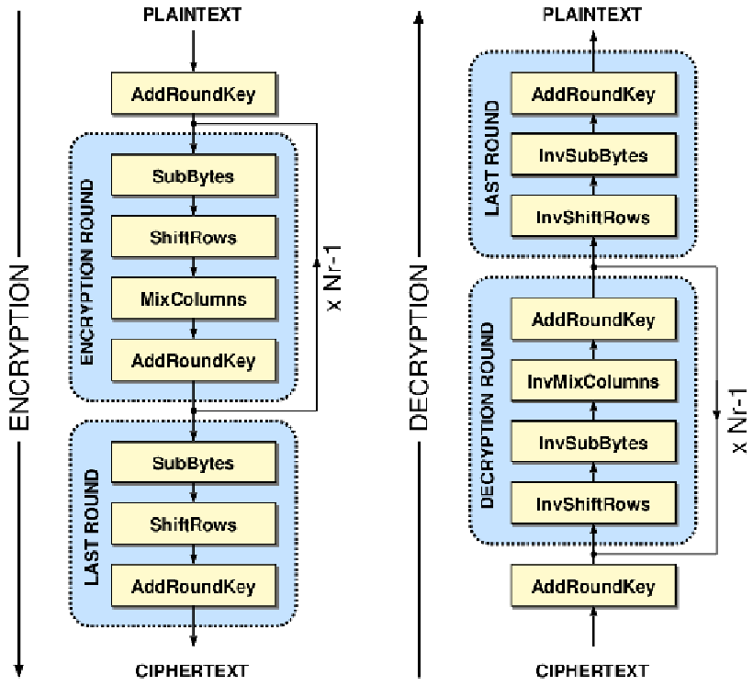
AES

Slide 48
Byte Substitution
• a simple substitution of each byte
• uses one table of 16x16 bytes containing a permutation of all 256 8-bit values
• each byte of state is replaced by byte in row (left 4-bits) & column (right 4-bits) – eg. byte {95} is replaced by row 9 col 5 byte – which is the value {2A}
• S-box is constructed using a defined transformation of the values in GF(28 ) • designed to be resistant to all known attacks

Slide 49
Shift Rows
• a circular byte shift in each row
– 1 st row is unchanged
– 2 nd row does 1 byte circular shift to left
– 3rd row does 2 byte circular shift to left
– 4th row does 3 byte circular shift to left
• decrypt does shifts to right
• since state is processed by columns, this step permutes bytes between the columns

Slide 50
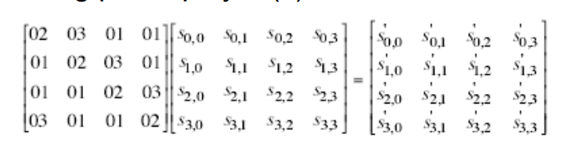
Mix Columns
• each column is processed separately
• each byte is replaced by a value dependent on all 4 bytes in the column
• effectively a matrix multiplication in GF(28 ) using prime poly m(x) =x8+x4+x3+x+1

Slide 51
Add Round Key
• XOR state with 128-bits of the round key
• again processed by column (though effectively a series of byte operations)
• inverse for decryption is identical since XOR is own inverse, just with correct round key
• designed to be as simple as possible

Slide 52
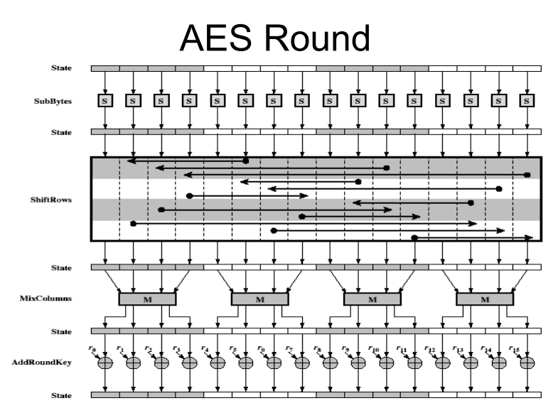

Slide 53
AES Key Expansion
• takes 128-bit (16-byte) key and expands into array of 44/52/60 32-bit words
• start by copying key into first 4 words
• then loop creating words that depend on values in previous & 4 places back – in 3 of 4 cases just XOR these together – every 4th has S-box + rotate + XOR constant of previous before XOR together
• designed to resist known attacks

Slide 54

Chapter 9 – Public Key Cryptography and RSA
"We improve our online presence"
Every Egyptian received two names, which were known respectively as the true name and the good name, or the great name and the little name; and while the good or little name was made public, the true or great name appears to have been carefully concealed. —The Golden Bough, Sir James George Frazer

Slide 55
Private-Key Cryptography
• traditional private/secret/single key cryptography uses one key
• shared by both sender and receiver
• if this key is disclosed, communications are compromised
• also is symmetric, parties are equal
• hence does not protect sender from receiver forging a message & claiming is sent by sender

Slide 56
Public-Key Cryptography
• probably most significant advance in the 3000 year history of cryptography
• uses two keys – a public & a private key – Anyone knowing the public key can encrypt messages or verify signatures – But cannot decrypt messages or create signatures
• asymmetric since parties are not equal
• complements rather than replaces private key crypto

Slide 57
Public-Key Cryptography
• public-key/two-key/asymmetric cryptography involves the use of two keys:
– a public-key, which may be known by anybody, and can be used to encrypt messages, and verify signatures
– a private-key, known only to the recipient, used to decrypt messages, and sign (create) signatures • is asymmetric because – those who encrypt messages or verify signatures cannot decrypt messages or create signatures

Slide 58
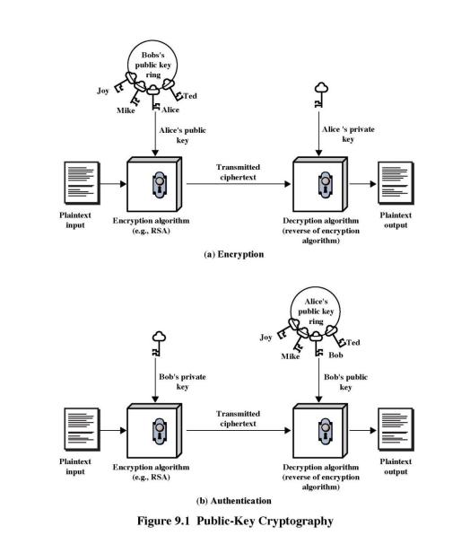
Public-Key Cryptography

Slide 59
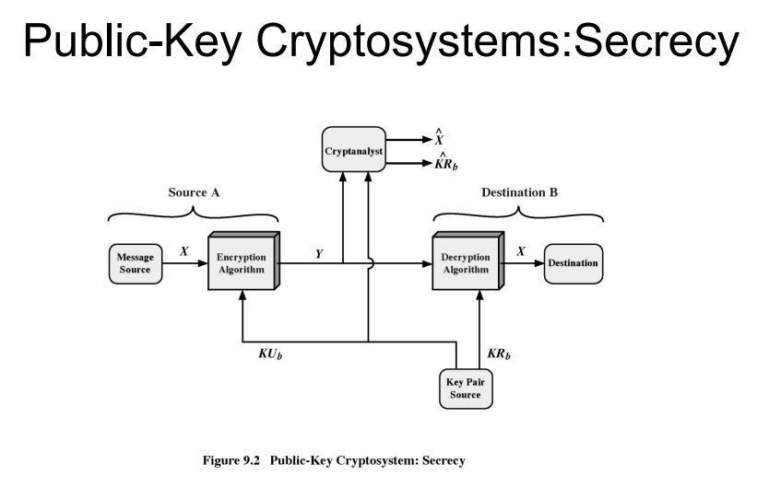

Slide 60
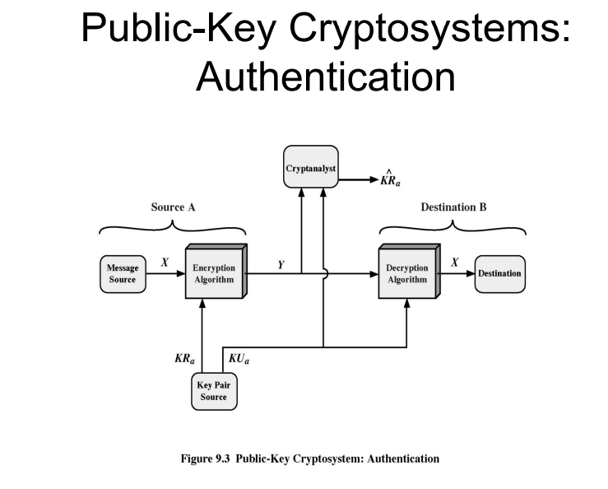

Slide 61
Public-Key Cryptography
• can classify uses into 3 categories:
– encryption/decryption (provide secrecy)
– digital signatures (provide authentication)
– key exchange (of session keys)
• some algorithms are suitable for all uses, others are specific to one

Slide 62
RSA
• by Rivest, Shamir & Adleman of MIT in 1977
• best known & widely used public-key scheme
• based on exponentiation of integers in a finite (Galois) field – Defined over integers modulo a prime – exponentiation takes O((log n)3 ) operations (easy)
• uses large integers (eg. 1024 bits)

Slide 63
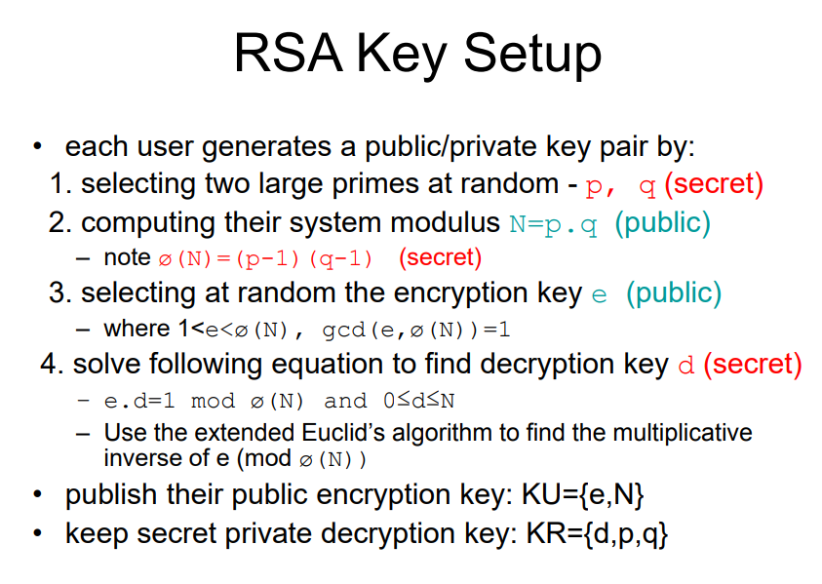
RSA

Slide 64
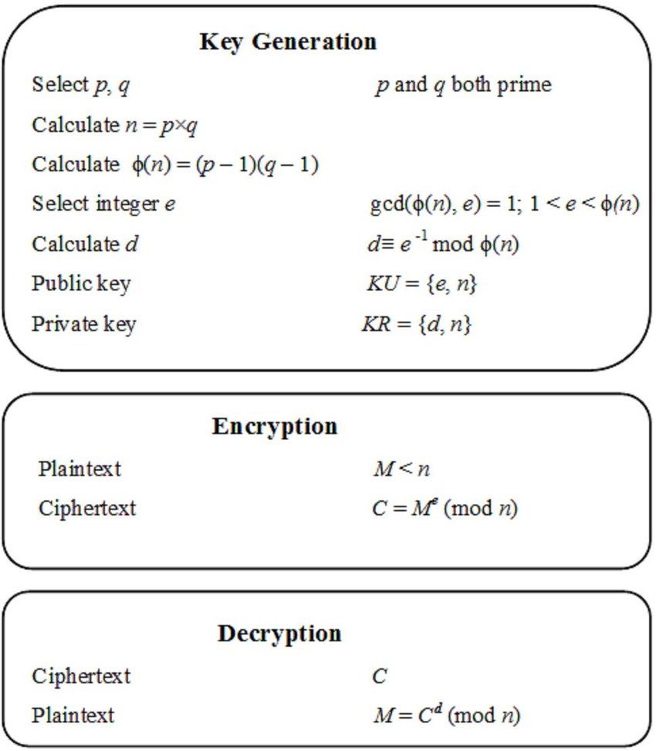

Slide 65
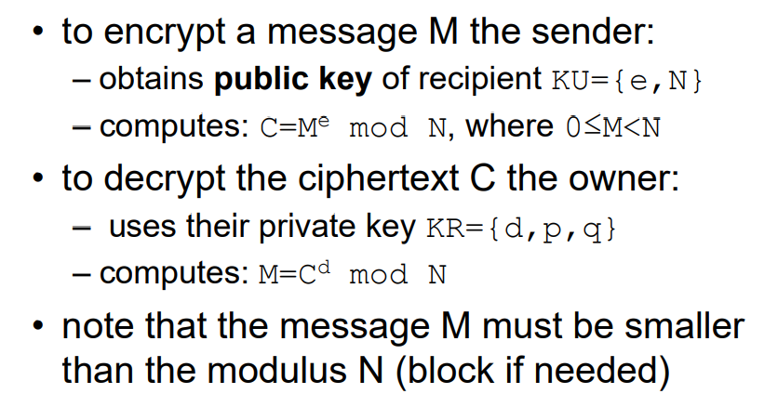
RSA Use

Slide 66
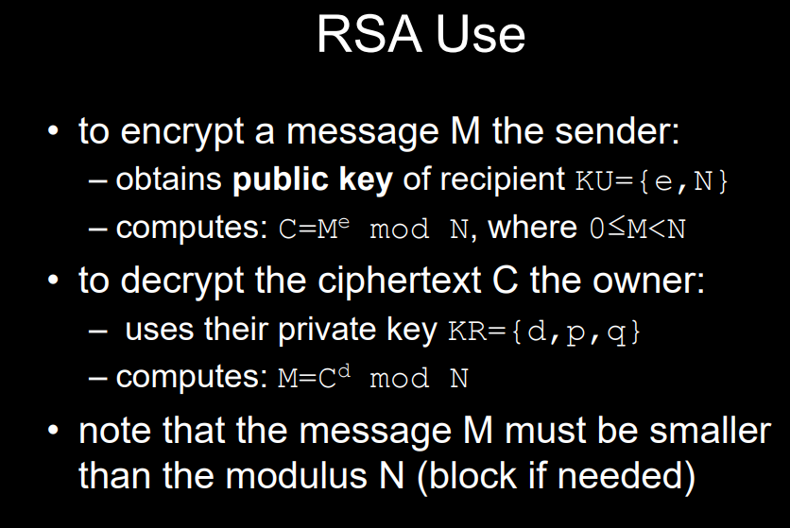

Slide 67
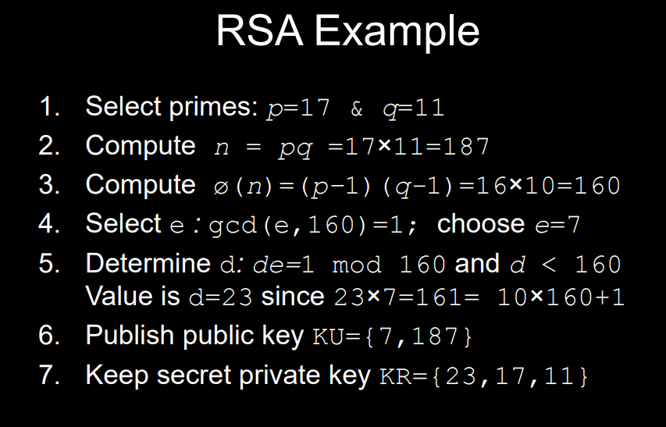

Slide 68
Chapter 10 – Key Management; Other Public Key Cryptosystems

Slide 69
https://web.cs.hacettepe.edu.tr/~maydos/Docs/crypto/ch10.pdf

Slide 70
Diffie-Hellman Key Exchange
• first public-key type scheme proposed
– For key distribution only
• by Diffie & Hellman in 1976 along with the exposition of public key concepts
– note: now know that James Ellis (UK CESG) secretly proposed the concept in 1970
• is a practical method for public exchange of a secret key • used in a number of commercial products

Slide 71
Diffie-Hellman Key Exchange
• a public-key distribution scheme
– cannot be used to exchange an arbitrary message – rather it can establish a common key – known only to the two participants
• value of key depends on the participants (and their private and public key information)
• based on exponentiation in a finite (Galois) field (modulo a prime or a polynomial) - easy
• security relies on the difficulty of computing discrete logarithms (similar to factoring) – hard

Slide 72
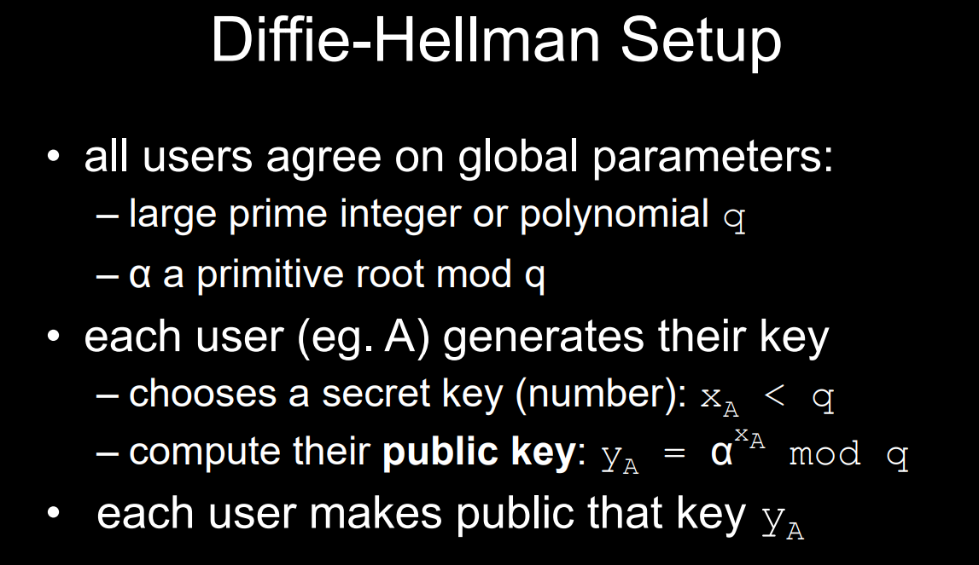

Slide 73
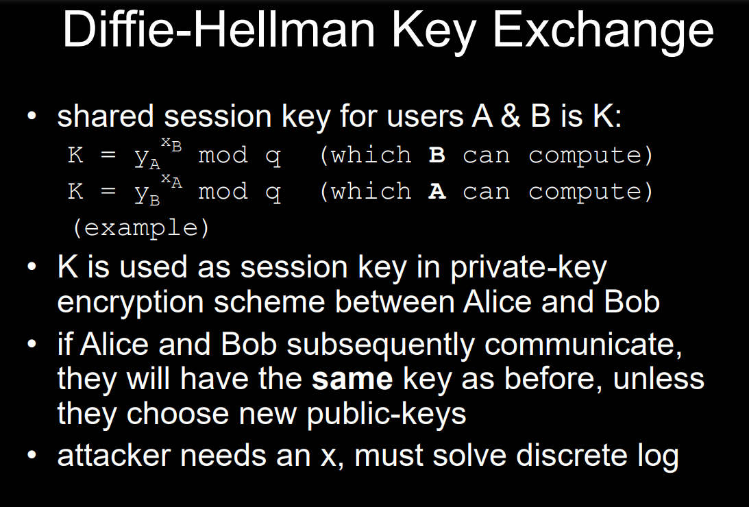

Slide 74
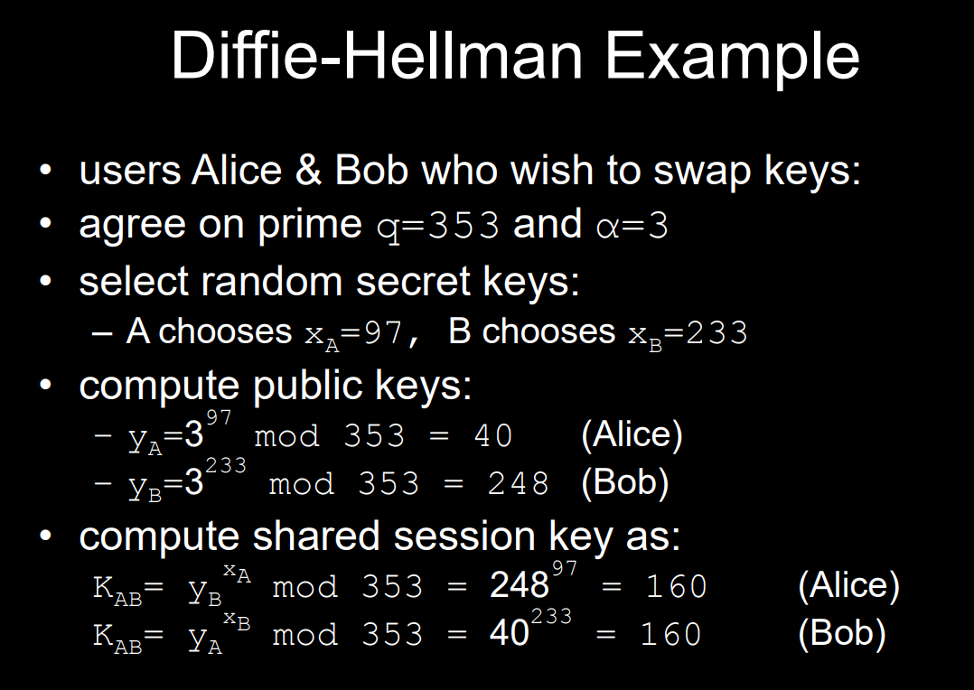

Slide 75
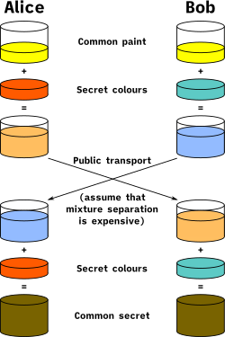

Slide 76
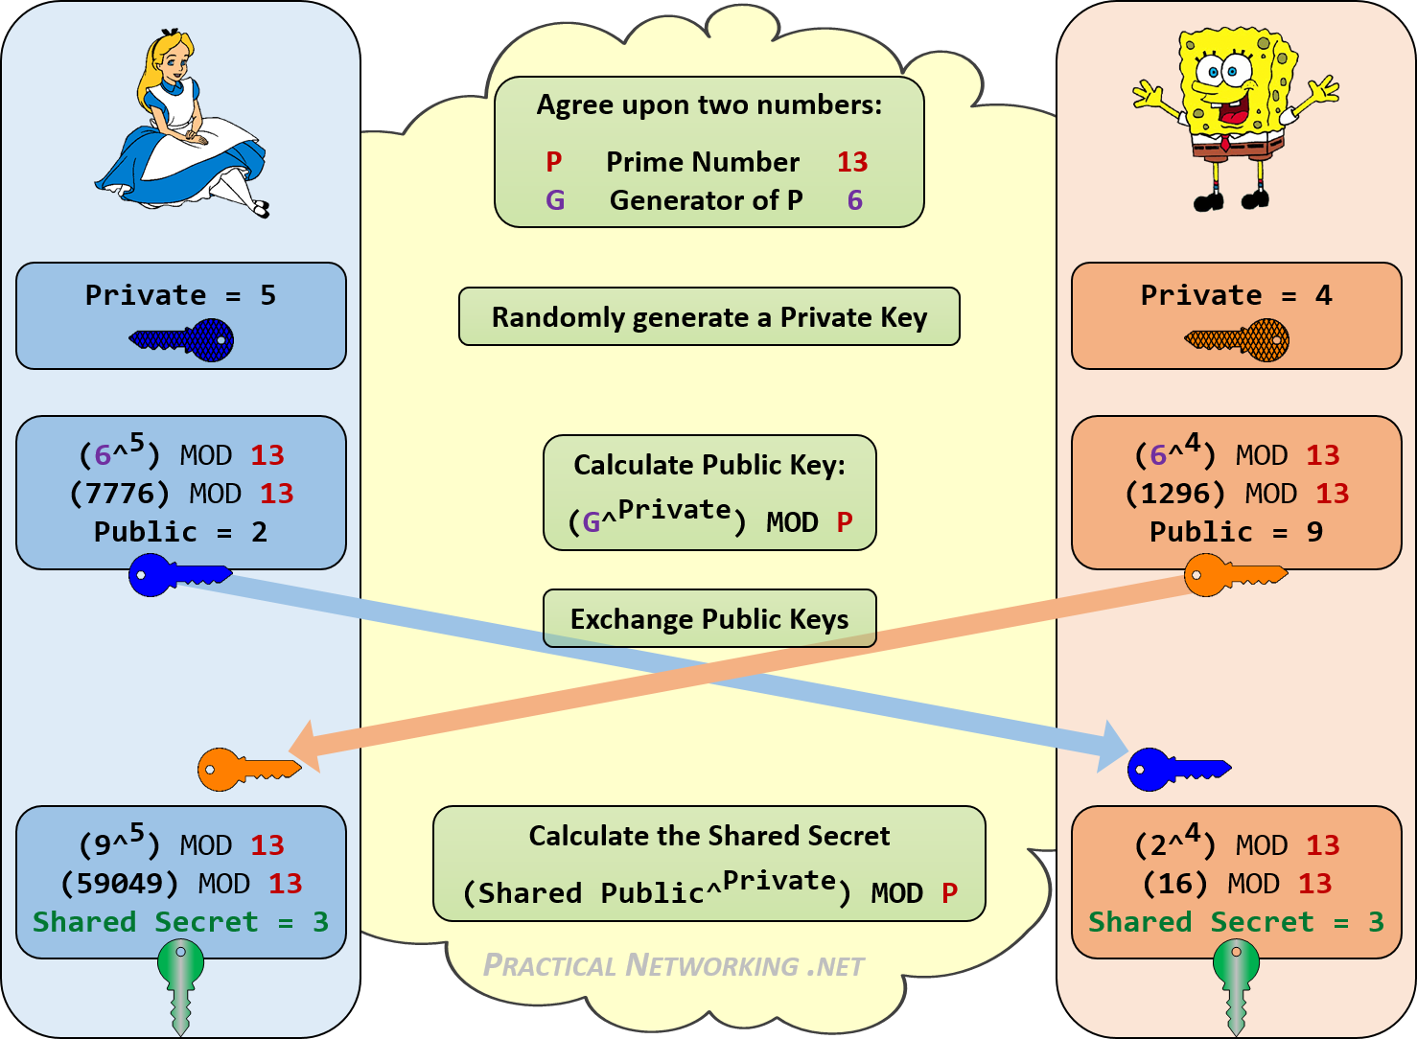

Slide 77
Elliptic Curve Cryptography
• majority of public-key crypto (RSA, D-H) use either integer or polynomial arithmetic with very large numbers/polynomials
• imposes a significant load in storing and processing keys and messages
• an alternative is to use elliptic curves
• offers same security with smaller bit sizes

Slide 78
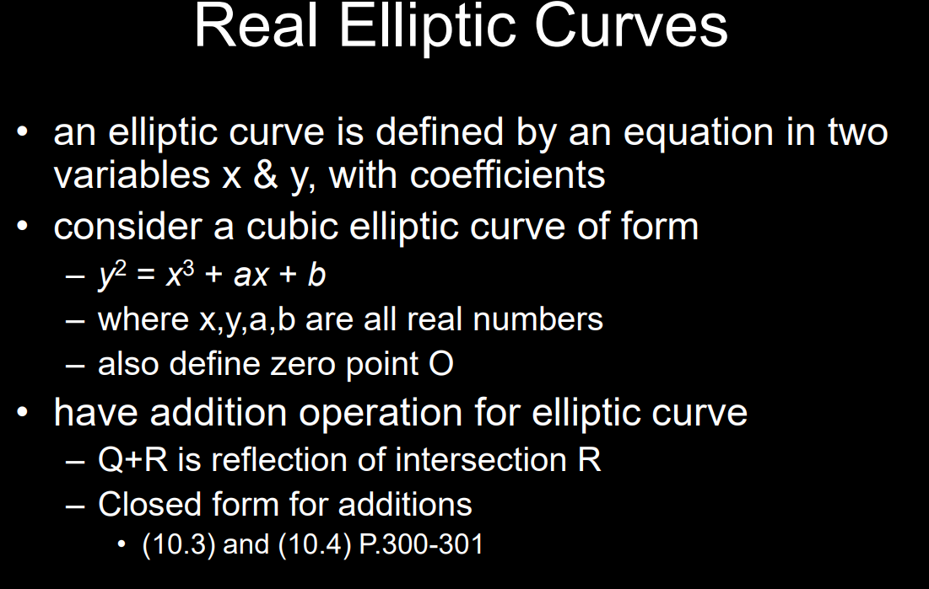
Elliptic Curve Cryptography

Slide 79
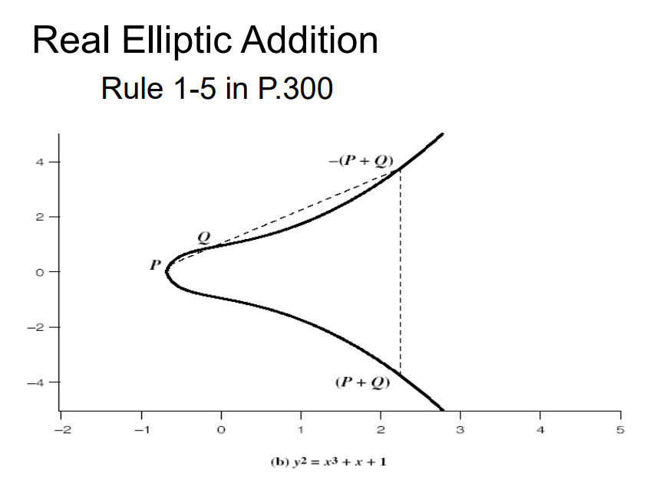
Elliptic Curve Cryptography

Slide 80
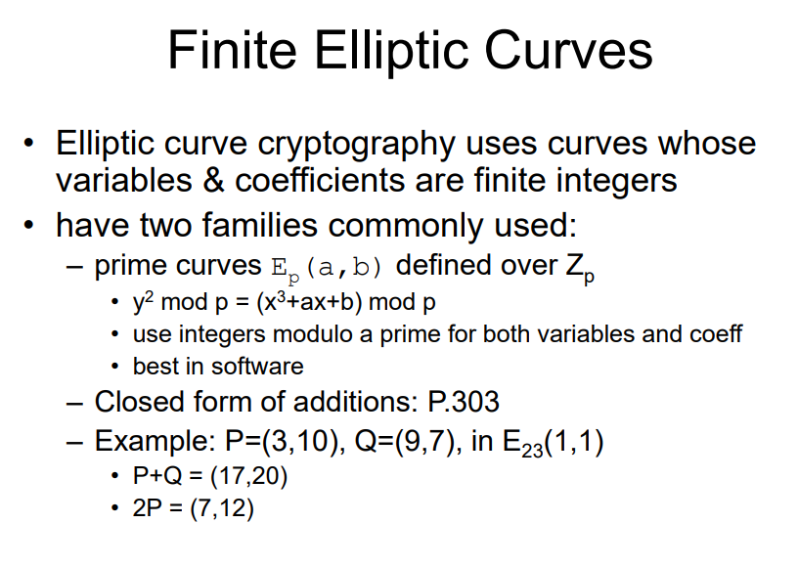
Elliptic Curve Cryptography

Slide 81
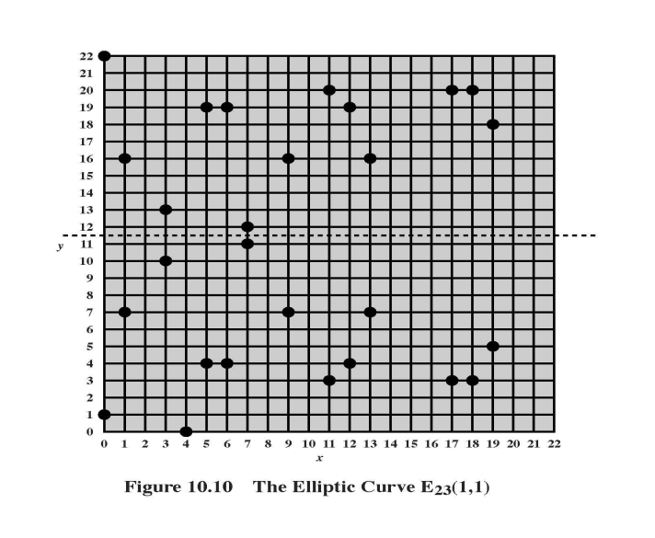
Elliptic Curve Cryptography

Slide 82
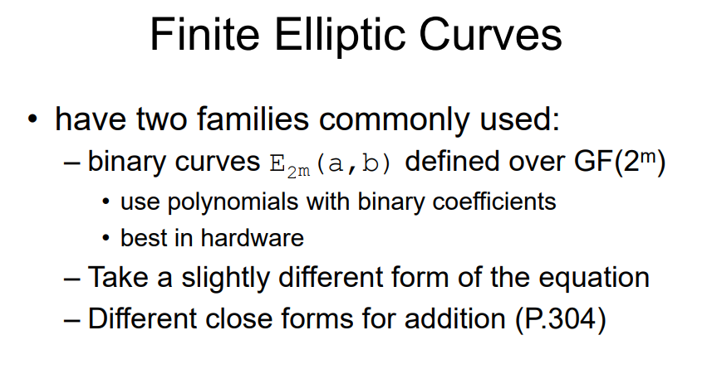
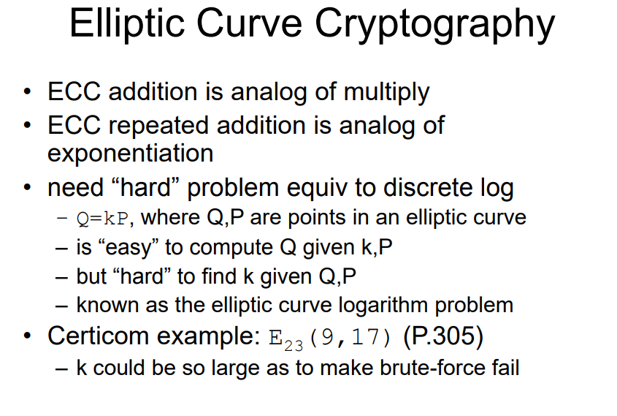
Elliptic Curve Cryptography

Slide 83
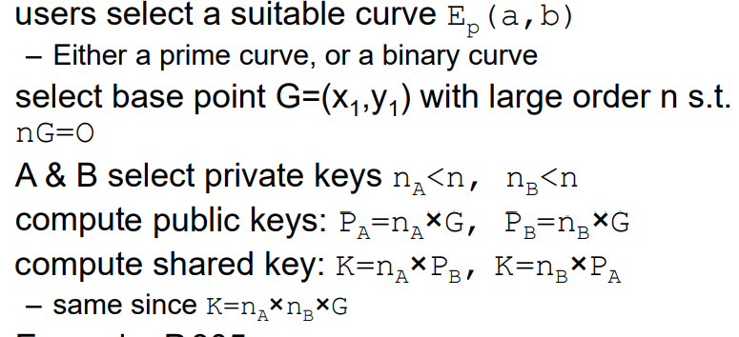
ECC Key Exchange
can do key exchange similar to D-H

Slide 84
Chapter 11 – Message Authentication and Hash Functions
At cats' green on the Sunday he took the message from the inside of the pillar and added Peter Moran's name to the two names already printed there in the "Brontosaur" code. The message now read: “Leviathan to Dragon: Martin Hillman, Trevor Allan, Peter Moran: observe and tail.” What was the good of it John hardly knew. He felt better, he felt that at last he had made an attack on Peter Moran instead of waiting passively and effecting no retaliation. Besides, what was the use of being in possession of the key to the codes if he never took advantage of it? —Talking to Strange Men, Ruth Rendell

Slide 85
Message Authentication
• protecting message content (ie secrecy) by encrypting the message
• now consider – how to protect message integrity (ie protection from modification) –
confirming the identity of the sender
• then three alternative functions used:
– message encryption (the ciphertext itself is the authenticator)
– message authentication code (MAC)
– hash function

Slide 86
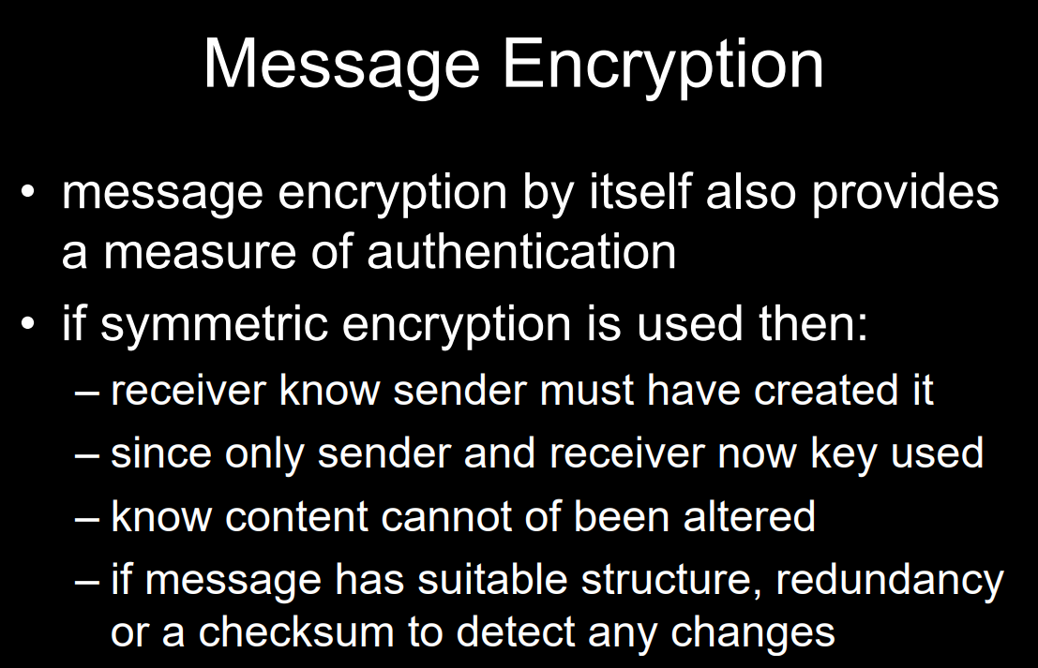
Message Authentication

Slide 87
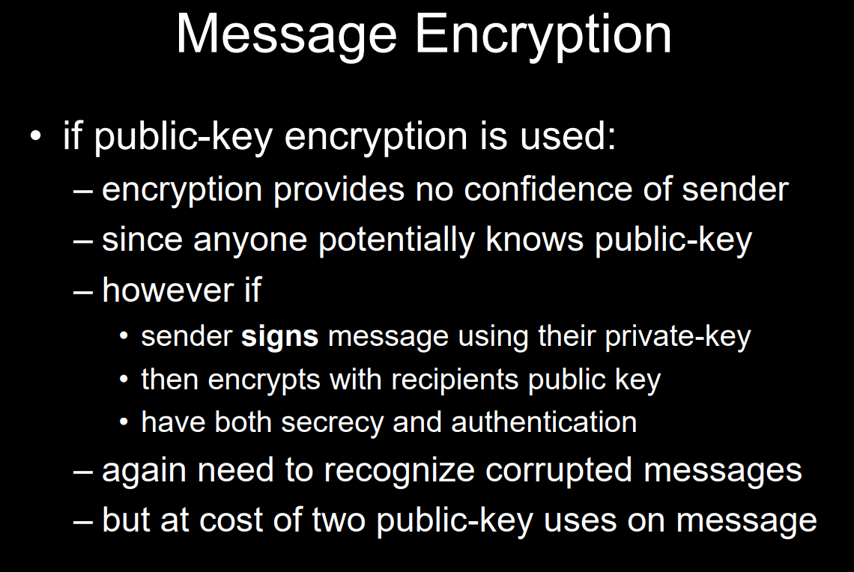
Message Authentication

Slide 88
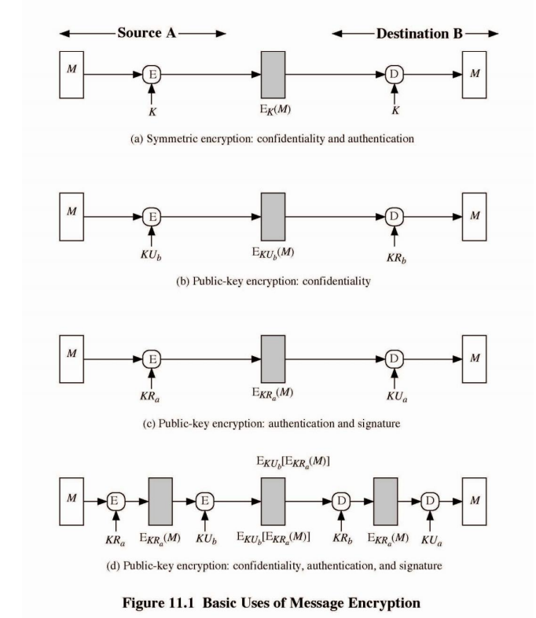

Slide 89
Message Authentication Code (MAC)
• generated by an MAC function C that creates a small fixed-sized block
– depending on both message M and a shared secret key K, MAC=CK (M)
– MAC is appended to the message M
• receiver performs same computation on message and checks it matches the MAC
• provides assurance that message is unaltered and comes from sender

Slide 90
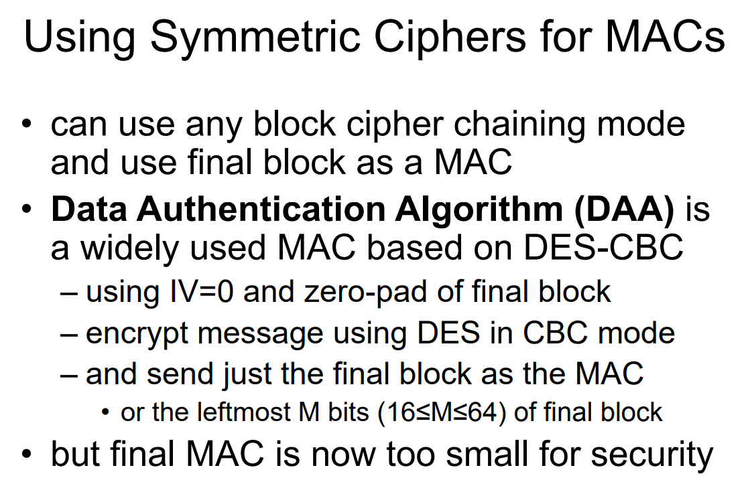
Message Authentication Code (MAC)

Slide 91
Hash Functions
• condenses arbitrary message to fixed size
• usually assume that the hash function is
public and not keyed
– cf. MAC which is keyed
• used to detect changes to message
• can use in various ways with message
• most often to create a digital signature

Slide 92
Hash Function Properties
• a Hash Function produces a fingerprint of some file/message/data h = H(M)
– condenses a variable-length message M – to a fixed-sized fingerprint
• assumed to be public

Slide 93
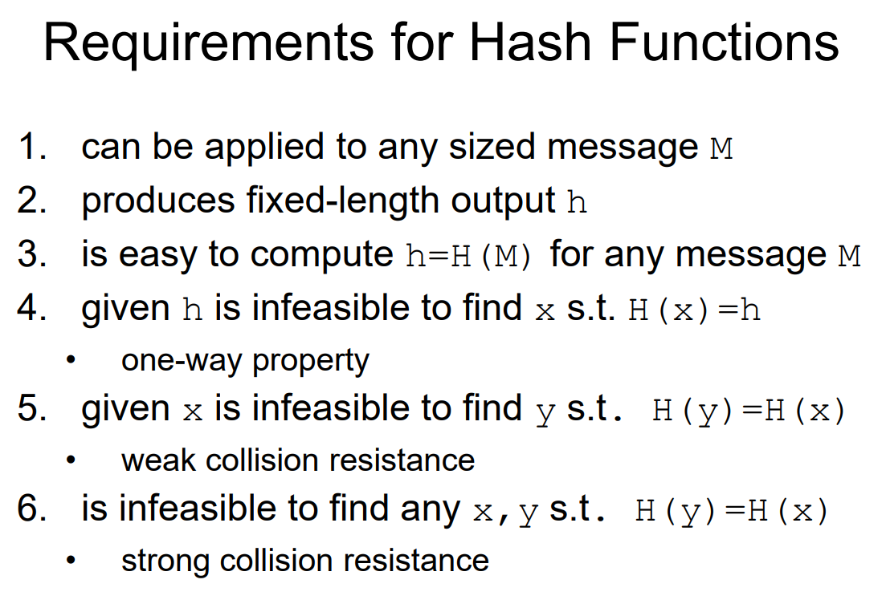
Hash Function Properties

Slide 94
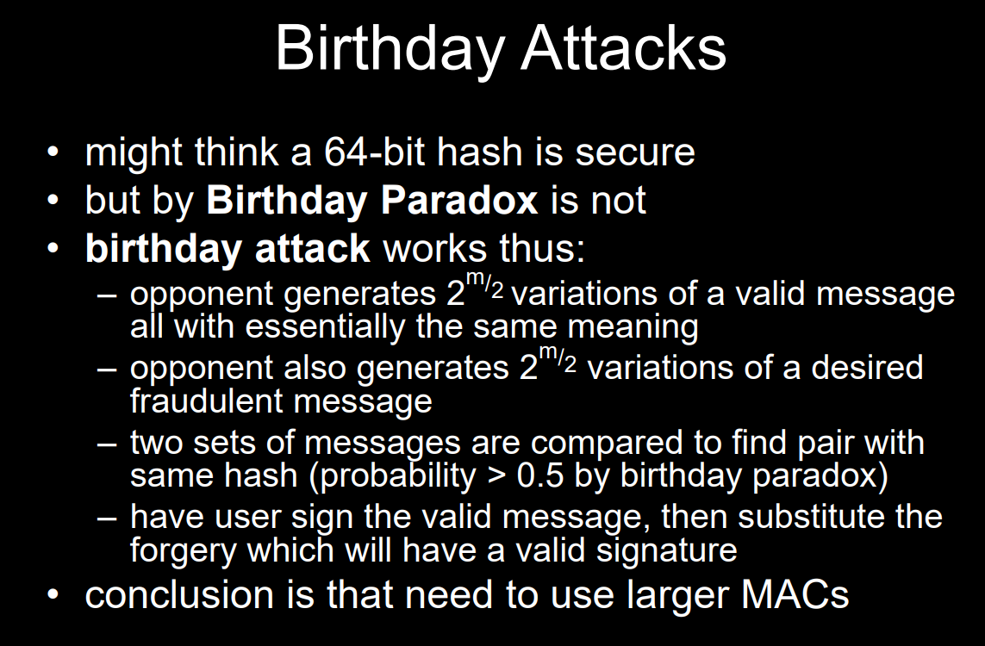
BIRTHDAY

Slide 95
Chapter 12 – Hash Algorithms
Each of the messages, like each one he had ever read of Stern's commands, began with a number and ended with a number or row of numbers. No efforts on the part of Mungo or any of his experts had been able to break Stern's code, nor was there any clue as to what the preliminary number and those ultimate numbers signified. —Talking to Strange Men, Ruth Rendell

Slide 96
Hash Algorithms
• see similarities in the evolution of hash functions & block ciphers – increasing power of brute-force attacks – leading to evolution in algorithms – from DES to AES in block ciphers – from MD4 & MD5 to SHA-1 & RIPEMD-160 in hash algorithms • likewise tend to use common iterative structure as do block ciphers

Slide 97

Hash Algorithms

Slide 98
MD5
• designed by Ronald Rivest (the R in RSA)
• latest in a series of MD2, MD4
• produces a 128-bit hash value
• until recently was the most widely used hash algorithm – in recent times have both brute-force & cryptanalytic concerns
• specified as Internet standard RFC1321

Slide 99
MD5 Overview
1. pad message so its length is 448 mod 512
• Padding of 1-512 bits is always used.
• Padding: 1000….0
2. append a 64-bit length value to message
• Generate a message with 512L bits in length
3. initialise 4-word (128-bit) MD buffer (A,B,C,D)
4. process message in 16-word (512-bit) blocks:
5. output hash value is the final buffer value

Slide 100


Slide 101


Slide 102


Slide 104


Slide 105
Secure Hash Algorithm (SHA-1)
• SHA was designed by NIST & NSA in 1993, revised 1995 as SHA-1
• US standard for use with DSA signature scheme – standard is FIPS 180-1 1995, also Internet RFC3174
– nb. the algorithm is SHA, the standard is SHS • produces 160-bit hash values
• now the generally preferred hash algorithm
• based on design of MD4 with key differences

Slide 106


Slide 107


Slide 108

Chapter 13 –Digital Signatures & Authentication Protocols

Slide 109
Digital Signatures
• have looked at message authentication – but does not address issues of lack of trust – Mary may forge a message and claim it came from John – John can deny sending a meesage
• digital signatures provide the ability to: – verify author, date & time of signature – authenticate message contents – be verified by third parties to resolve disputes
hence include authentication function with additional capabilities

Slide 110
Digital Signatures
must depend on the message being signed
• must use information unique to sender
– to prevent both forgery and denial
• must be relatively easy to produce
• must be relatively easy to recognize & verify
• be computationally infeasible to forge
– with new message for existing digital signature
– with fraudulent digital signature for given message
• be practical save a copy of the digital signature
in storage

Slide 111
Direct Digital Signatures
• involve only sender & receiver
• assumed receiver has sender’s public-key
• digital signature made by sender signing entire message or hash with private-key
• can further encrypt using receivers public-key
• important that sign first then encrypt message & signature • security depends on sender’s private-key – Have problems if lost/stolen

Slide 112
Arbitrated Digital Signatures
• involves use of arbiter A
– validates any signed message
– then dated and sent to recipient
• requires a great deal of trust in arbiter
• can be implemented with either private or public-key algorithms
• arbiter may or may not see message

Slide 113


Slide 114
Authentication Protocols
• used to convince parties of each others identity and to exchange session keys
• may be one-way or mutual
• key issues are
– confidentiality – to protect session keys
– timeliness – to prevent replay attacks
Replay Attacks
• where a valid signed message is copied and
later resent
– simple replay
– repetition that can be logged
– repetition that cannot be detected
– backward replay without modification
• countermeasures include
– use of sequence numbers (generally impractical)
– timestamps (needs synchronized clocks)
– challenge/response (using unique nonce)

Slide 115
Using Symmetric Encryption
• as discussed previously can use a twolevel hierarchy of keys
• usually with a trusted Key Distribution Center (KDC)
– each party shares own master key with KDC
– KDC generates session keys used for connections between parties
– master keys used to distribute these to them

Slide 116


Slide 117


Slide 118
One-Way Authentication
• required when sender & receiver are not in communications at same time (eg. email)
• have header in clear so can be delivered by email system
• may want contents of body protected & sender authenticated
– The receiver wants some assurance of the identity of the alleged sender

Slide 119
One-Way Authentication
• required when sender & receiver are not in communications at same time (eg. email)
• have header in clear so can be delivered by email system
• may want contents of body protected & sender authenticated
– The receiver wants some assurance of the identity of the alleged sender

Slide 120

One-Way Authentication

Slide 121


Slide 122
Digital Signature Standard (DSS)
• A public-key scheme for digital signature use only, combines hash and encryption
• designed by NIST & NSA in early 90's
• DSS is the standard, DSA is the algorithm
– Based on number theory
– security depends on difficulty of computing discrete logarithms
– creates a 320 bit signature, but with 512-1024 bit security
– Computationally efficient

Slide 123
Thanks
intro to crypto

